Slide 1
Pulse width modulation
By: Abhishek B.

Slide 2
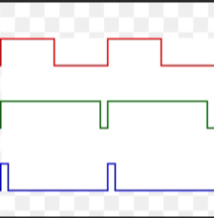
What is pwm?
Reduces the power delivered by electrical signal
Cuts up the signal by turning the power supply on and off
Method of getting analog input from a digital apparatus

Slide 3
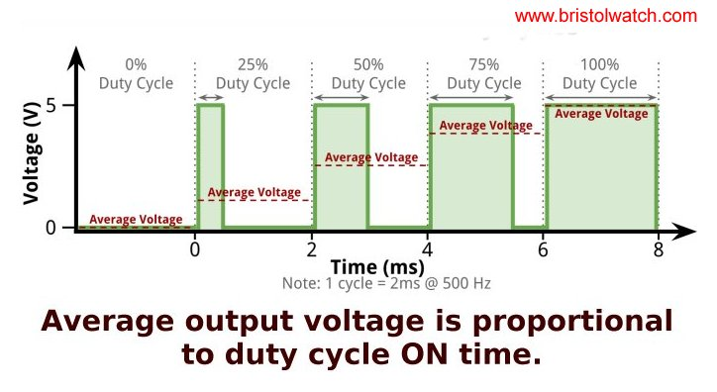


Terminology
Average Voltage: the average amount of voltage a device gets in one cycle
Off Time: the time when the electrical signal is Off
On Time: the time when the electrical signal is On
Duty Cycle: the ratio of On Time to Time Period, calculated in percentage
Cycle: it is one On Time and one Off Time
Time Period: the amount of time one cycle takes, calculated in units of time (seconds, milliseconds, etc.)
Notes:
Formula for Duty Cycle: On Time divided by the Time Period
Formula for Average Voltage: Maximum Voltage times Duty Cycle (percentage)

Slide 4
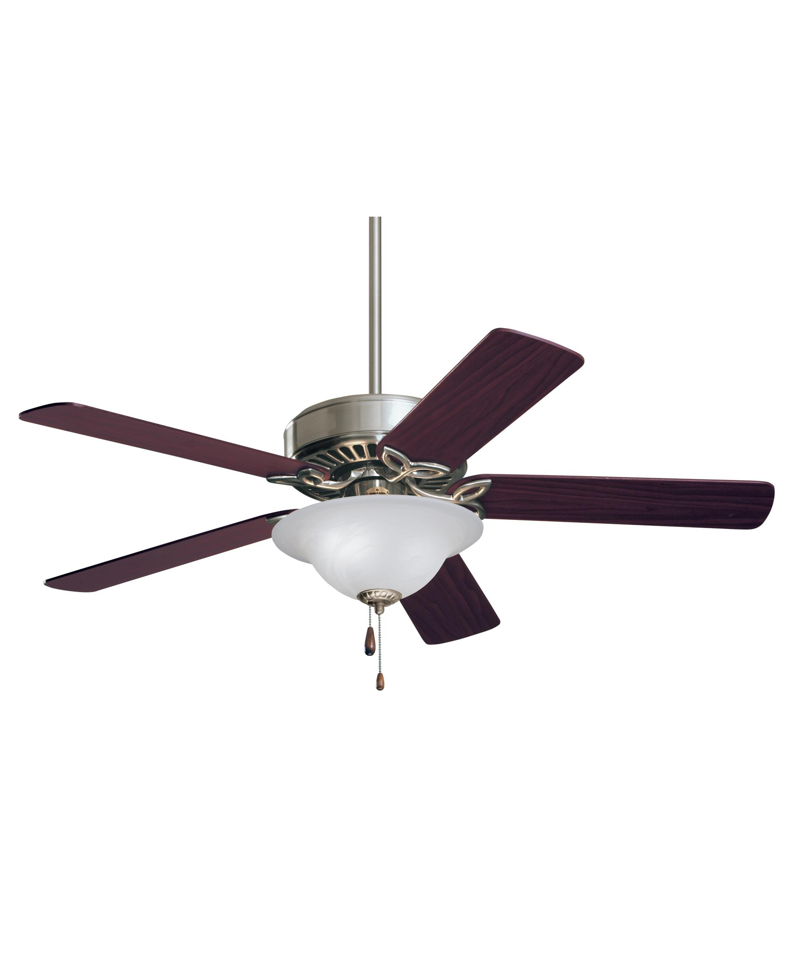

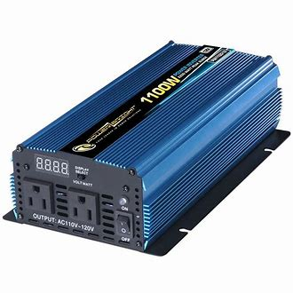
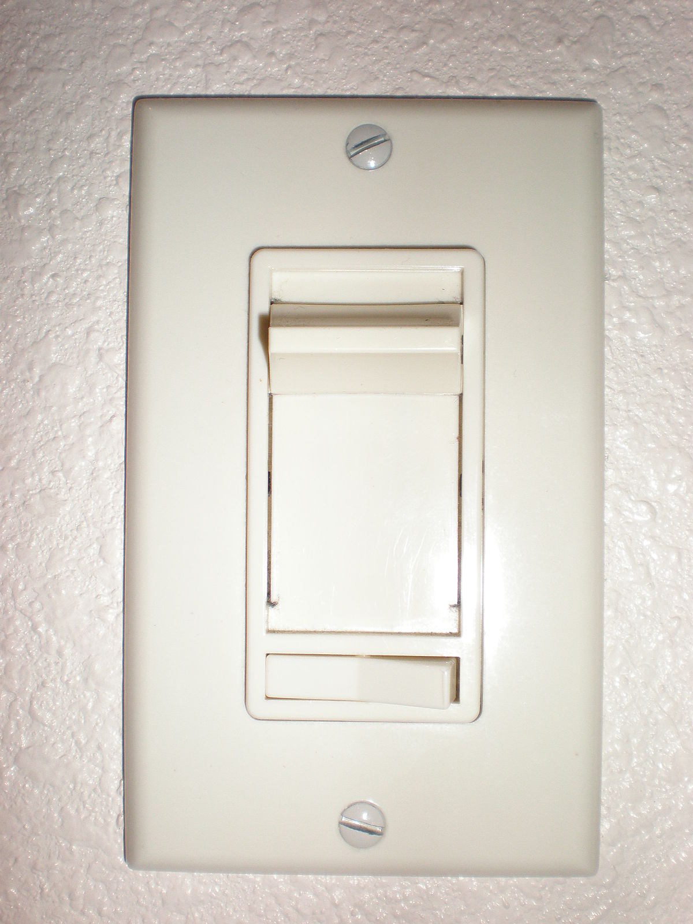



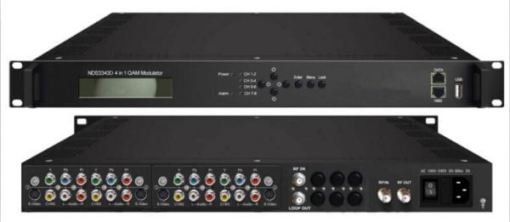
Applications

Slide 5
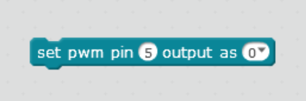

PWM in mblock
Notes:
Range of 0-255
50% Duty cycle: 127
25% Duty cycle: 63
75% Duty cycle: 191

Slide 6
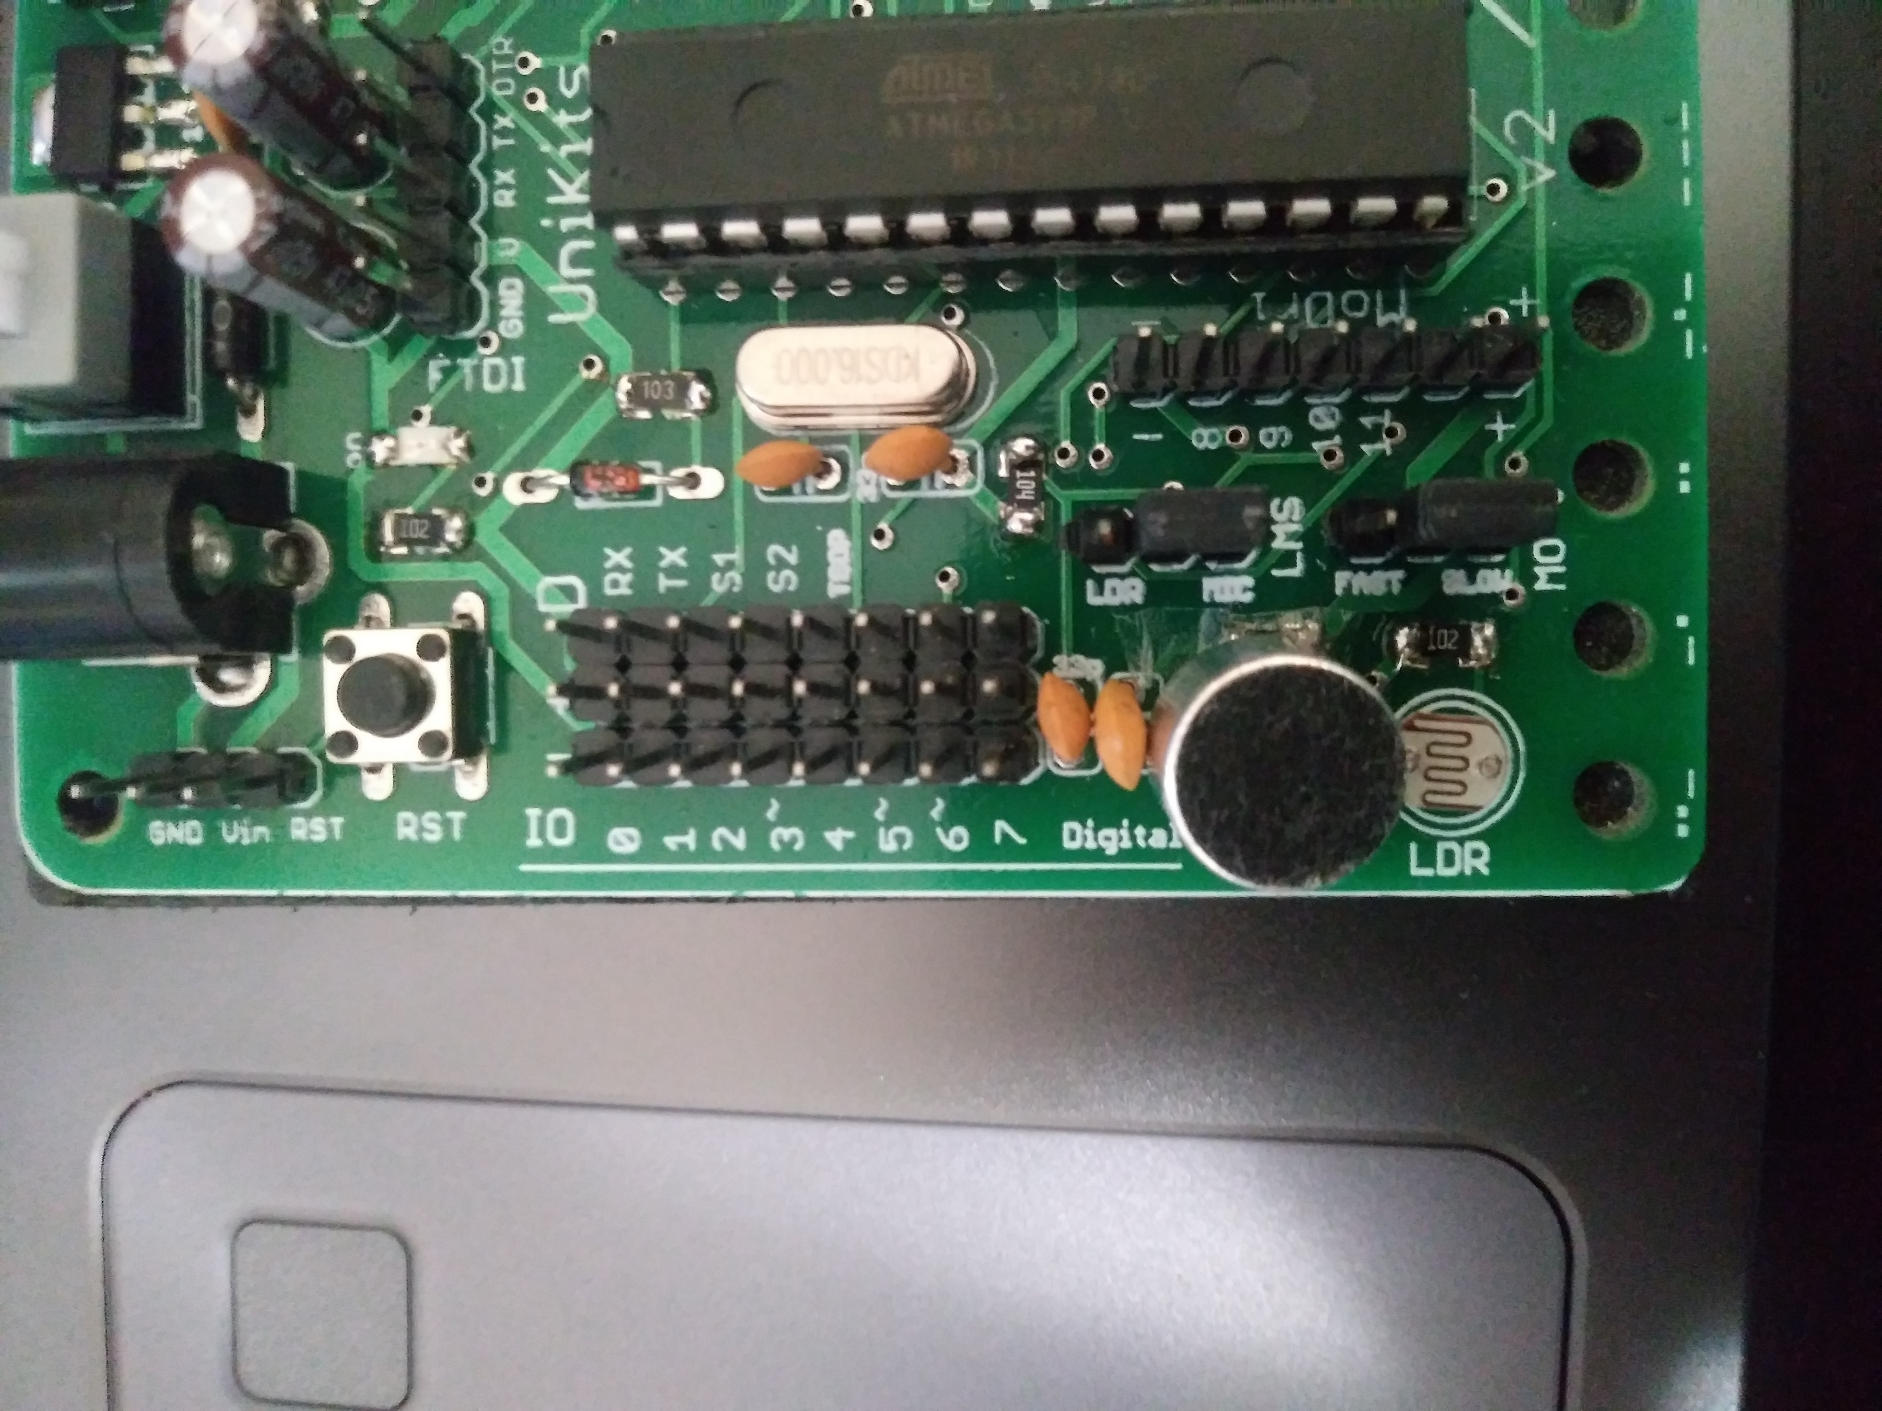
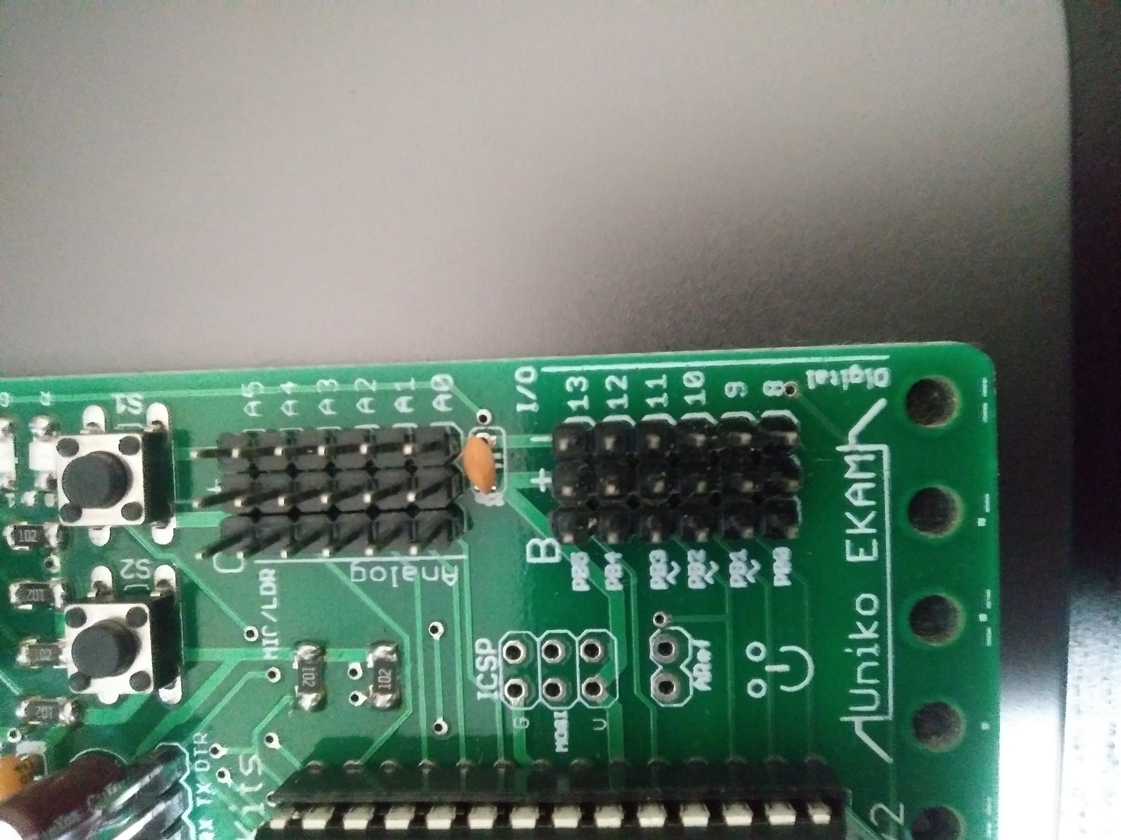

Pwm on uniko ekam board

Slide 7
The end

